Slide 1
Data Mining Online Communities
Ruslan Rozenfeld & Brandon Nolan

Slide 2
JSOUP
A java API for web scraping
Part of the Maven Repository
Useful for parsing and manipulating HTML elements
Open source project distributed under the MIT license

Slide 3
Comparing two websites
(Amazon & NewEgg)
Explore trends of these two online shopping communities
The datasets for this project looked specifically at the electronics catalog of both communities but could be easily adapted to look at catalogs
Collected data the two communities shared such as:
Item Name
Price
Reviews / Number of reviews
Item category

Slide 4
How the program works
Requires a few parameters before it begins scraping the catalog data:
URL
CSS selectors
How many pages to be read
Other modular parameters specific to each website (amazon & newegg)
Output file
Run the program and the collected data is sent to the specified output file

Slide 5
Quick Demo &
Look at the code

Slide 6
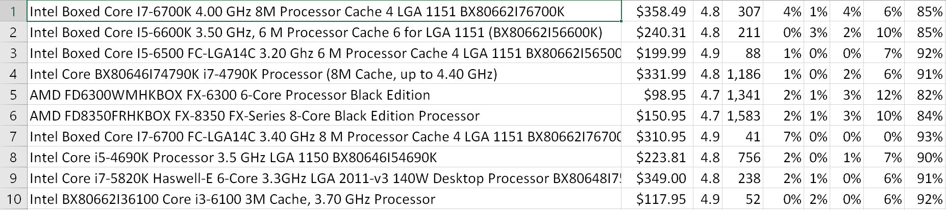
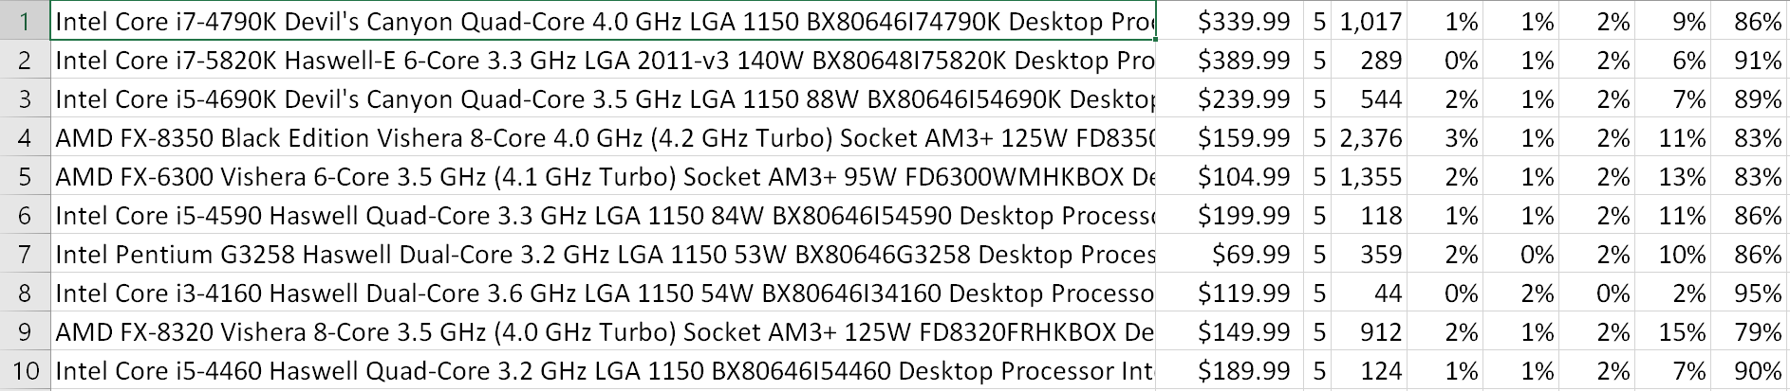
Sample Dataset
This is a sample dataset looking at the CPU listings of both communities
Amazon
NewEgg

Slide 7
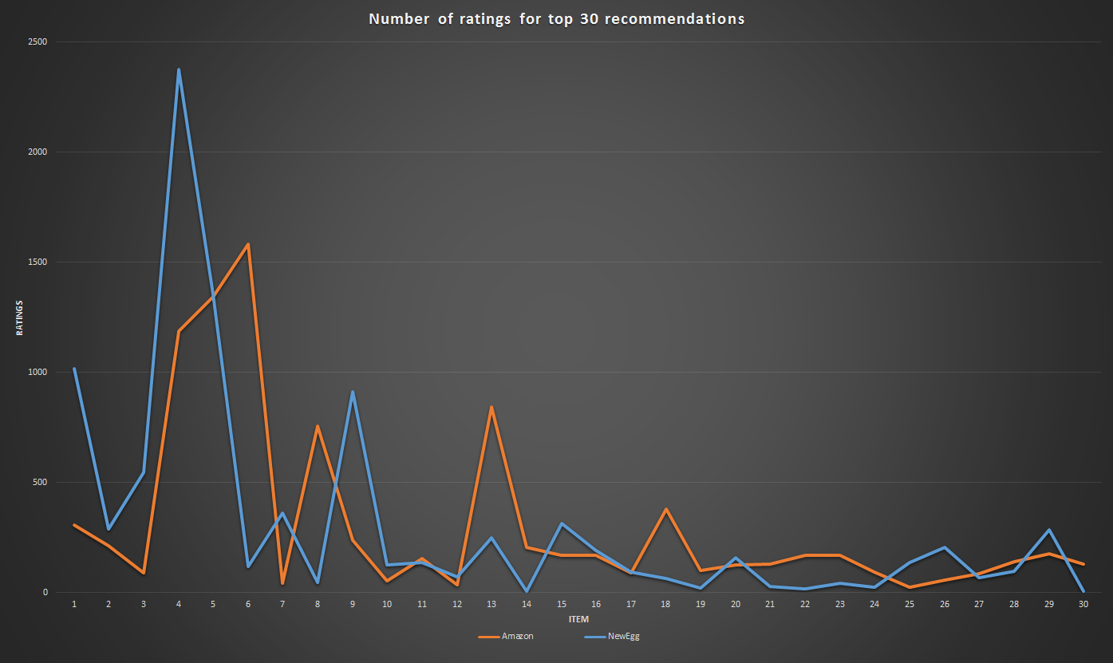
Looking at the trends

Slide 8
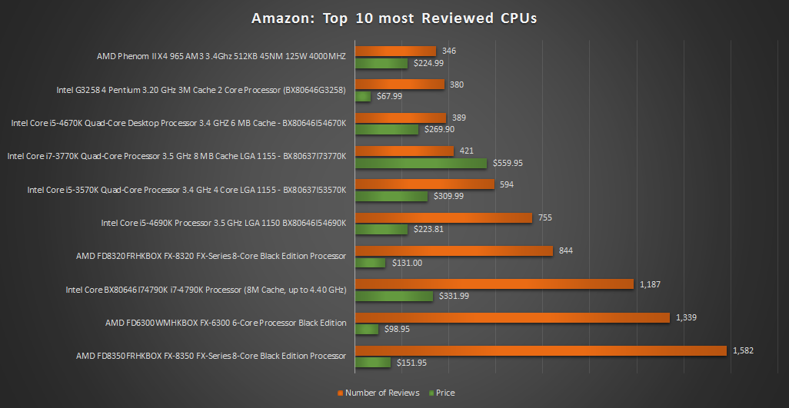
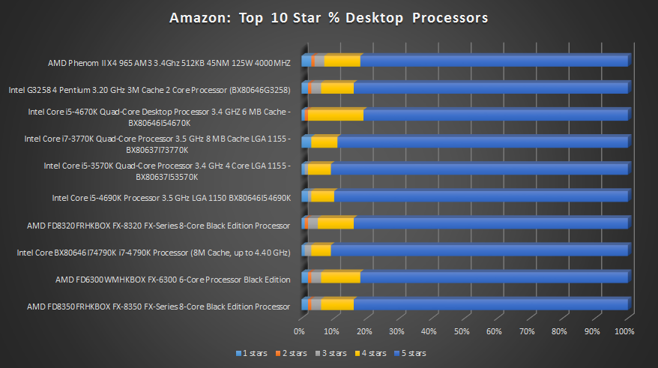
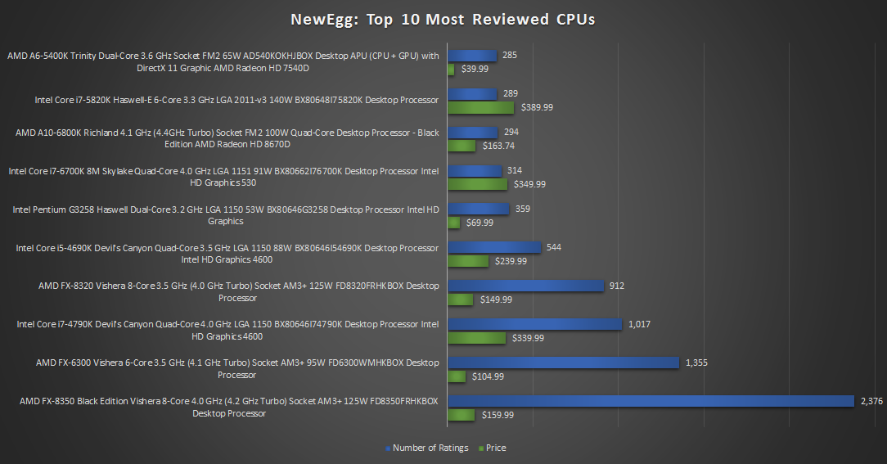
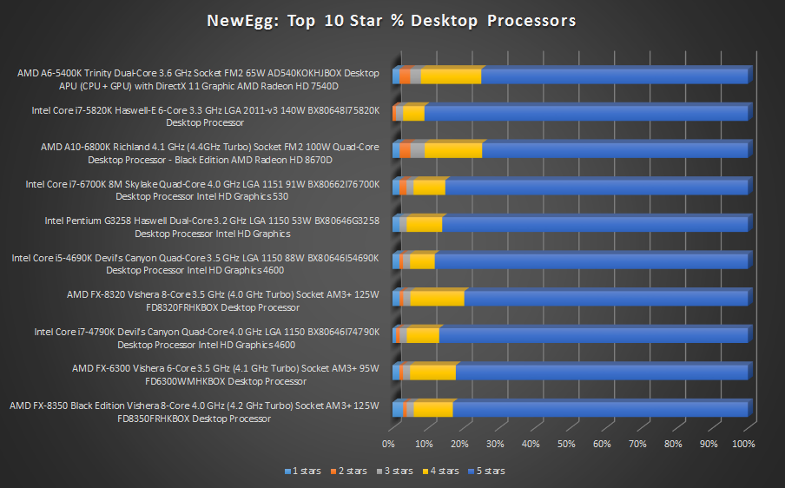

Slide 9
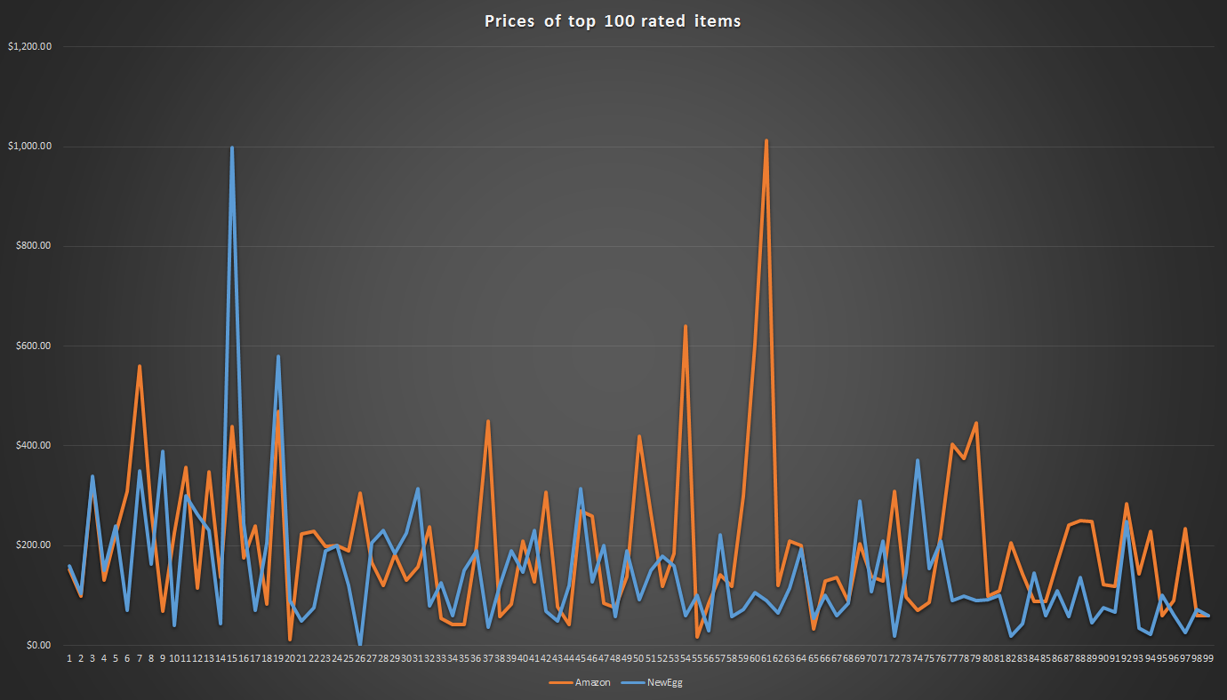

Slide 10
Future work
Related future studies could focus on finding correlations in any other online communities
Future data collected could help find trends that may or may not be present in other communities
Trends found may provide insight and aid in building other projects such as recommendation systems for various online communities

